Slide 1




CUSTOMER PERSONAS
Presented by team Car Care

Slide 2
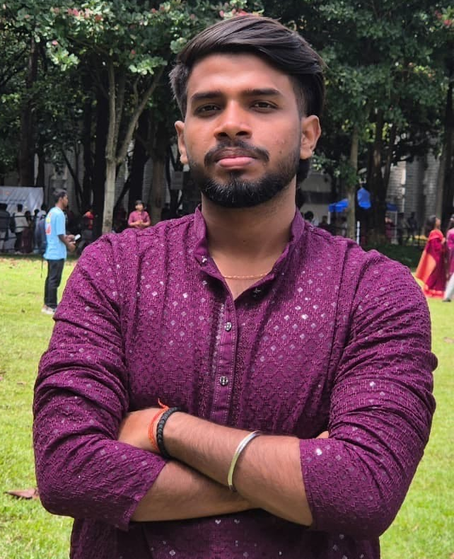

ABOUT THE USER
ABOUT THE USER
Saswat is an engineering student .His internship workspaces involves covering long distance .He loves traveling and going long drives.
Down-to-earth
Easy-going
Reliable
PROBLEMS
GOALS AND NEEDS
Sanjeev
Garage location in times of emergency
Customer support not stable.
At Service centers part not available
Garage locating + AI application for services stores = Easy car maintenance
24 years old
Engineering Student
CHALLENGES
Immediate garage locating
Contacting right customer care on time
Searching service stores

Slide 3
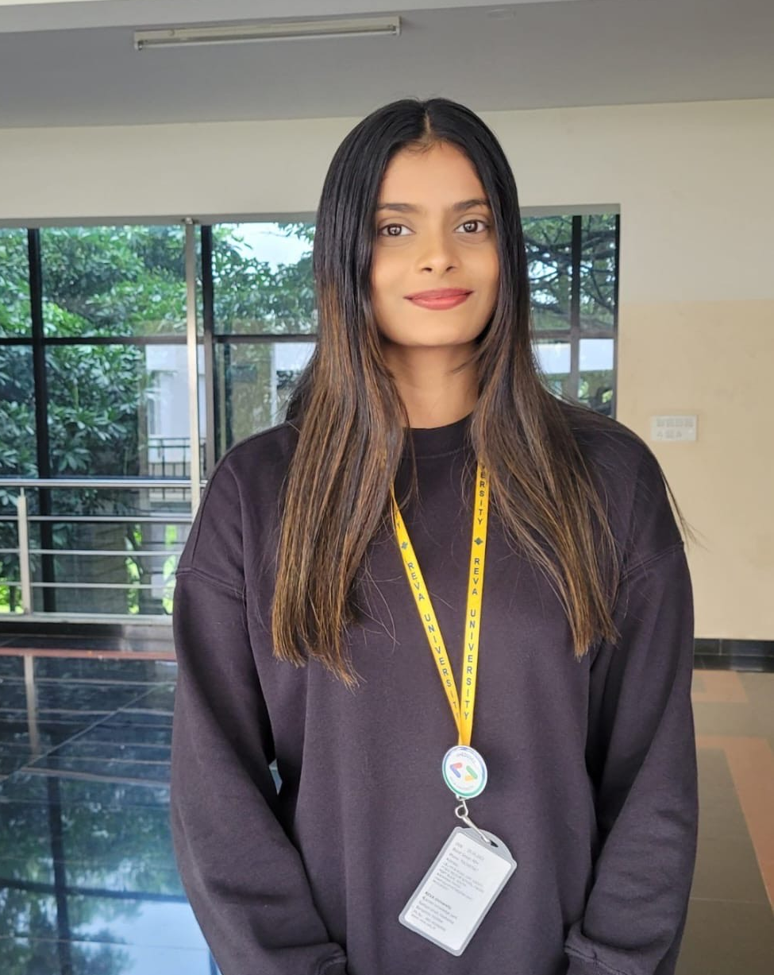
.
ABOUT THE USER
ABOUT THE USER
She loves using smart technology and connects her car’s OBD device with the app . Wants to tracks her car’s performance metrics and gives insights like fuel efficiency and wear patterns. Make services cheaper.
Goal-oriented
Visionary
PROBLEMS
GOALS AND NEEDS
Aastha
Too much raw car data, not easy to understand
Time constraints for manual bookings
Too expensive car services
Privacy concerns with connected car data
Data-driven diagnostics + smart scheduling = hassle-free car management with expense tracking
23 years old
Engineering Student
CHALLENGES
Converting technical data into simple insights.
Ensuring seamless AI-driven automation that’s accurate.
Search flexible rates
Securely storing and processing sensitive user information

Slide 4
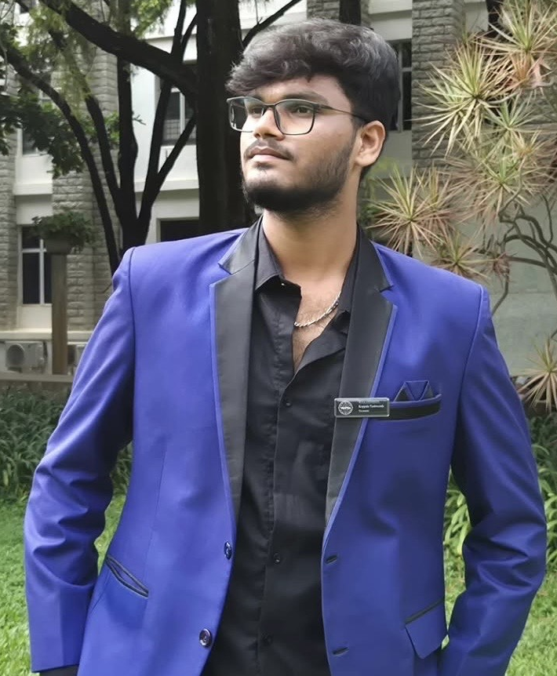
.
.
ABOUT THE USER
ABOUT THE USER
Involved with Corporate Sales / Marketing.He drives every week to meet clients . Since involved with startups ,expects reasonable rates for car services.
Strategic
Persuasive
Innovative
Analytica
PROBLEMS
GOALS AND NEEDS
Yashwanth
No time for regular maintenance
Difficulty finding affordable premium services
Tracking multiple vehicles for business use
Predictive maintenance + route-based service recommendations = No travel delays.
24 years old
Business Owner
CHALLENGES
automating service booking with minimal user input.
optimizing pricing without compromising quality.
designing scalable dashboards for fleet management

Slide 5
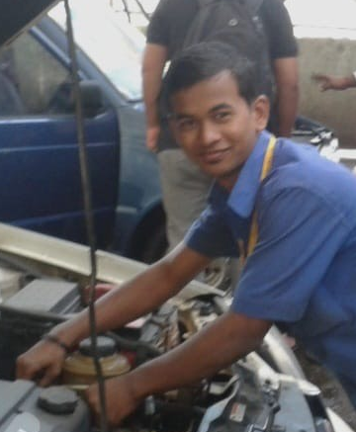
ABOUT THE USER
ABOUT THE USER
Down-to-earth
Hard working
Reliable
Inspiring
Problem solver
He’s a verified mechanic and located in remote area . Offers reasonable price range with good services but less of customers due to poor networking
PROBLEMS
GOALS AND NEEDS
Ahmed
Inconsistent customer flow
Miscommunication with customers
Difficulty tracking payments
Smart job matching + demand forecasting = more business, less idle time.
30 years old
Mechanic
CHALLENGES
Balancing job distribution through AI matching
Integrating clear, multilingual AI chat features.
Transactions securely and efficiently

Slide 6
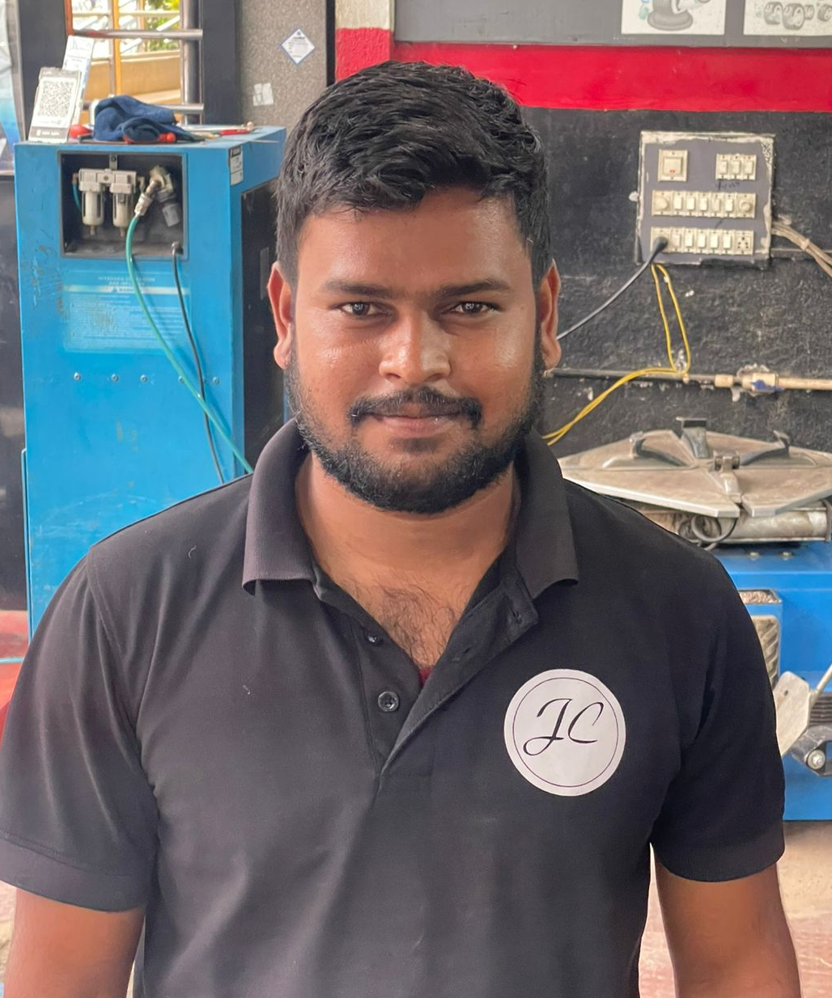
ABOUT THE USER
ABOUT THE USER
He is a hardworkingmechanic..Involves regular car maintenance and tracking of scheduled services for cars and ,finds it hard to keep the track manually and locate parts of car required for service.
Goal-oriented
Visionary
PROBLEMS
GOALS AND NEEDS
Mahesh
Forgetting service schedules
Difficulty finding trusted parts of car in reasonable price
Less customers
Predictive maintenance + service recommendations = Trusted and Successful analysis
32 years old
Mechanic
CHALLENGES
Providing fast, location-based help in remote areas.
Syncing AI reminders with travel frequency and car data.
Maintaining verified partners across multiple cities

Slide 7
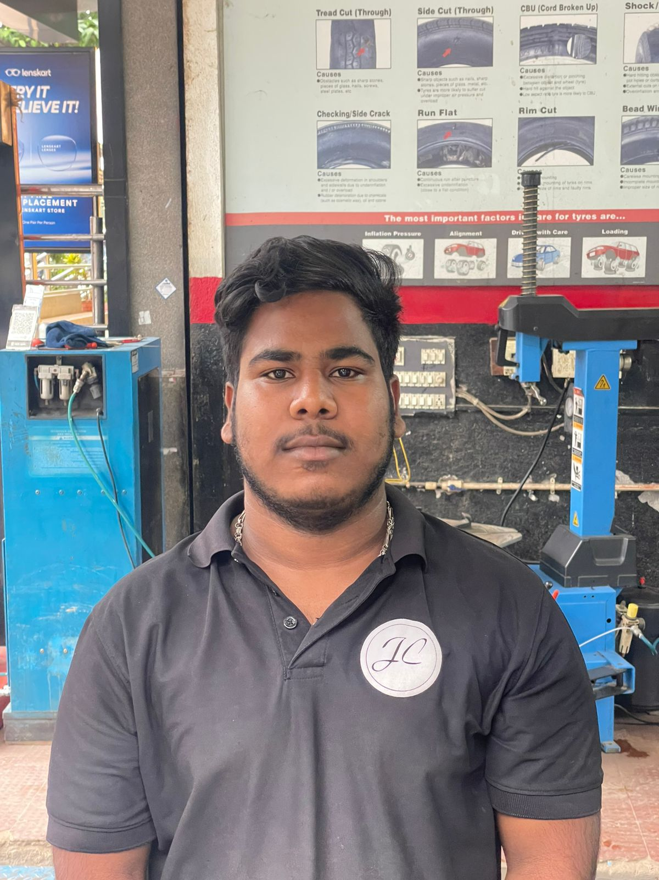
ABOUT THE USER
ABOUT THE USER
Hard working
Reliable
Inspiring
Problem solver
Punctual
He’s a mechanic and located in busy city . Offers reasonable price range with good services but finds it hard maintain multiple records of multiple cars
PROBLEMS
GOALS AND NEEDS
Vijay
Multiple records hard to manage
Miscommunication with customers
Difficulty tracking payments and searching for right parts for car
Smart job matching + demand forecasting = more business, less idle time.
28 years old
Mechanic
CHALLENGES
Balancing job distribution through AI matching
Integrating clear, multilingual AI chat features.
Transactions securely and efficiently and suggestions for parts required in nearest store

